Slide 1
BASIC CPU & CONTROL CIRCUITRY

Slide 2
CPU Selection
Motorola 68000
Motorola 68000 ColdFire
Zilog Z80

Slide 3
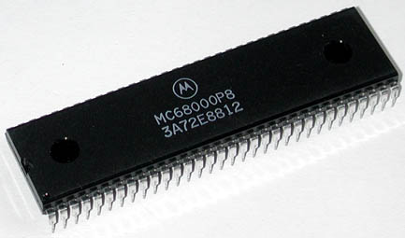
Motorola 68000

Slide 4
Motorola 68000 Overview
One of most commonly used MP and many documentations are available
MC68000L8/MC68000L10
24-bit addressing and 16-bit data bus
TI uses the 68000 family chip in its high-end graphing calculators (TI-89, TI-92, and Voyage 200)‏
Can communicate via a serial connection

Slide 5
Interesting places M68K devices are used
The 68349 is known as "Dragon I" and is the most powerful 683xx. The SONY Personal Digital Assistant (PDA) uses this device.
A Canadian firm, Crossbow Electronics in Richmond Hill Ontario make some interesting custom boards utilizing MC68K processors. Things like radar processing and satellite terminals.
Tee-Comm, a Canadian Direct-To-Home satellite systems manufacturer, uses the MC68306 microprocessor in its receiver-decoder.
The Winwriter 150c printer from Lexmark uses a 68EC000 processor.
The HP Deskjet series use Motorola CPUs.
The HP 9000/s300 workstations for many years used the 68010/20/30/40 series.
The new Amiga computers made by Escom in Europe use '040 and '060 processors.
The Sega Genesis used the 68000 and the Z80

Slide 6
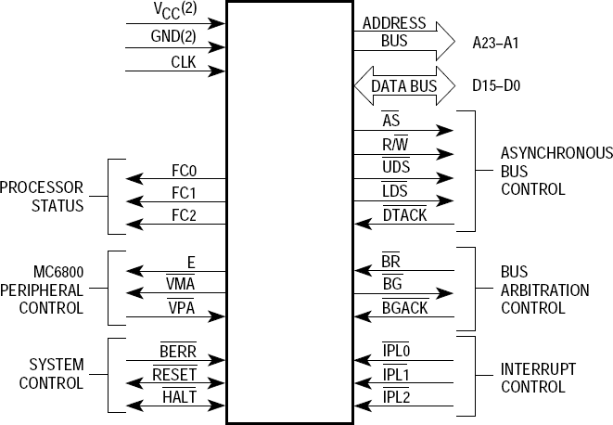
68000 Pin Configuration

Slide 7
68000 Interface Overview (cont’d)‏
M68000: 64 pins, arranged in 9 groups:
  Address Bus:
  Data Bus:
  Asynchronous bus control:
  Synchronous bus control:
  Bus arbitration control:
  Function code:
  System control:
  Interrupt control:
  Miscellaneous:
A01 – A23
D00 – D15
AS*, R/W*, UDS*, LDS*, DTACK*, BERR*
E, VPA*, VMA*
BR*, BG*, BGACK*
FC0, FC1, FC2
CLK, RESET*, HAL T*
IPL0*, IPL1*, IPL2*
Vcc(2), Gnd(2)‏
Asterisk following a name: indicates the signal is active low

Slide 8
68000 Interface – System Support
Power Supply
  +5V power supply: 2 Vcc pins and 2 ground pins
Clock
  Single-phase, TTL-compatible signal
RESET*
  Forces the 68000 into a known state on the initial application of power
  During power-up sequence must be asserted together with the HALT* input for at least 100 ms
HALT*
  In simple 68000 systems can be connected together with RESET*
  Can be used as an output, to indicate that the 68000 found itself in a situation from which it cannot recover (HALT* is asserted)‏

Slide 9
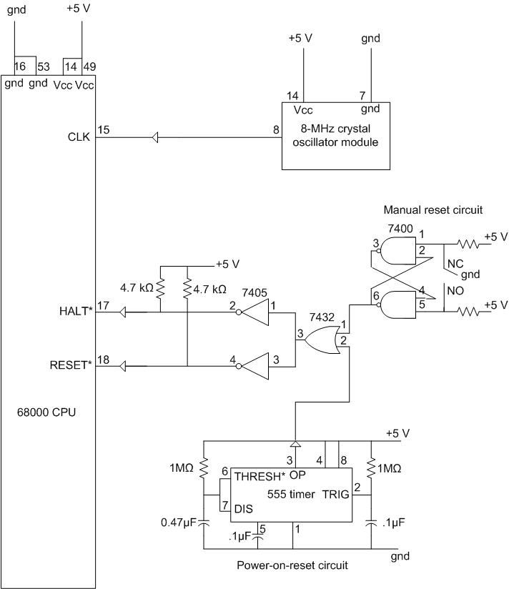
68000 Interface – System Support (cont’d)‏
Can use a Supervisor
chip (MAX690 Family)
instead
(based on Figure 4.2, p207)‏

Slide 10
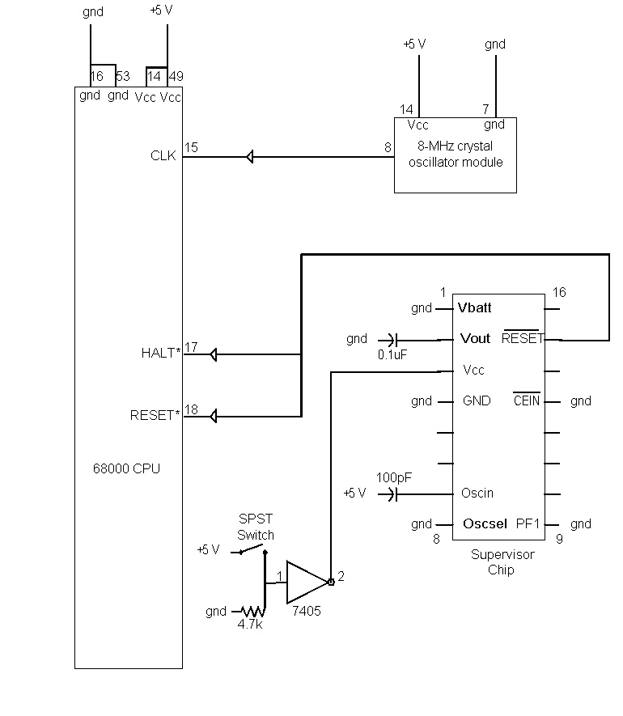
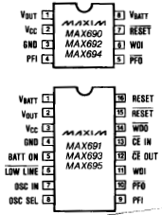
68000 Interface – System Support (cont’d)‏
MAX691/694 Supervisory Chip

Slide 11
68000 Interface – System Support (cont’d)‏
MAX690, 692 , 694 vs. MAX691, 693, 695
  Write protection for CMOS RAM or EEPROM
  Adjustable “Reset” and “Watchdog” timeout periods
  Separate outputs for watchdog timeout indication, backup-battery switchover, and low Vcc
Price: ~$7

Slide 12
68000 Interface – Memory and Peripherals
Address Bus
Data Bus
AS* (Address Strobe)‏
  Indicates that the address bus is valid when asserted
R/W* (Read/Write)‏
  Determines the type of a memory access cycle
UDS* and LDS* (Upper/Lower Data Strobe)‏
  Determines the size of data being accessed
DTACK* (Data Transfer Acknowledge)‏
  Handshake signal generated by device being accessed

Slide 13
68000 Interface – Memory and Peripherals
Note: A0, used to select the upper or lower byte, is not externally available (or needed)
Data Strobe Truth Table
WORD/BYTE*
A0
UDS*
(even byte)‏
LDS*
(odd byte)‏
1
x
0
0
0
0
0
1
0
1
1
0

Slide 14
68000 Interface – Special Function
BERR* (Bus Error)‏
  Enables the 68000 to recover from errors within the memory system
BR*, BG*, BGACK* (Bus Arbitration Control)‏
  Used to implement multiprocessor systems
FC0-FC2 (Function Code Output)‏
  Indicate the type of cycle currently being executed

Slide 15
68000 Interface – Special Function (cont’d)‏
IPL0*-IPL2* (Interrupt Control Interface)‏
  Indicates an external device requires service
  3-bit code specifies interrupt request level
  8 modes
    Level 0 – lowest priority, no interrupt is requested
    Level 7 – highest priority interrupt
  If not used, tie to +5 V (Level 0)‏
  Priority encoder converts the level of interrupt requests into the 3-bit code that is applied to IPL0*-IPL2*
  Interrupt request is serviced only if it has a higher value than what is in the interrupt mask bits

Slide 16
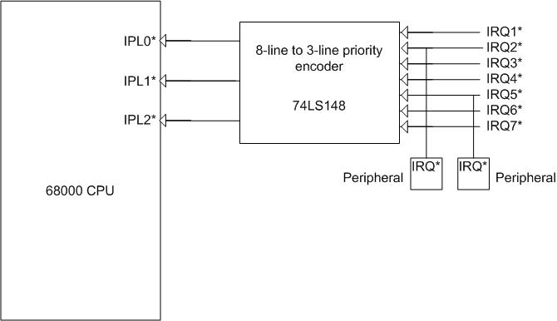
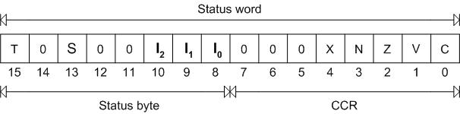
68000 Interface - Interrupt Control
(Figure 6-4,
p440)‏
(Figure 2.5,
p24)‏

Slide 17
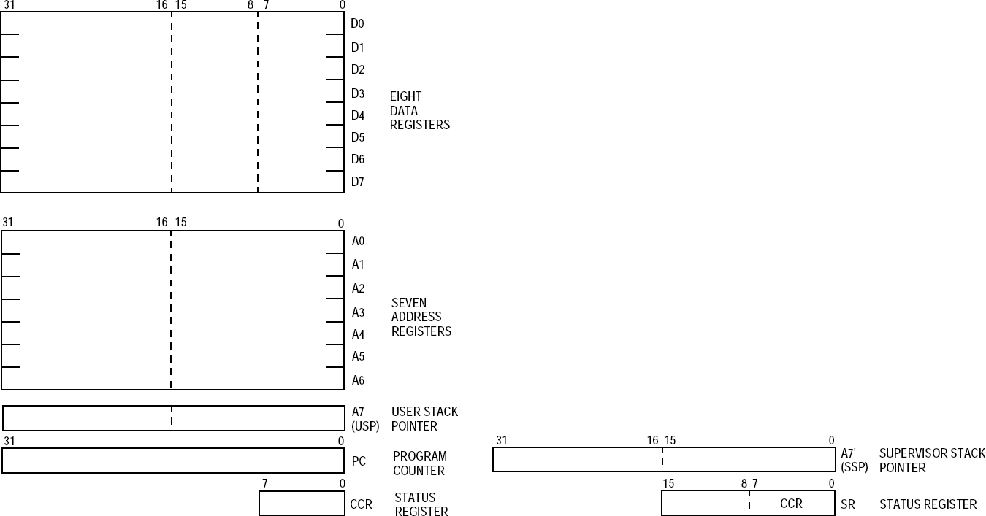
68000 Integral Registers

Slide 18
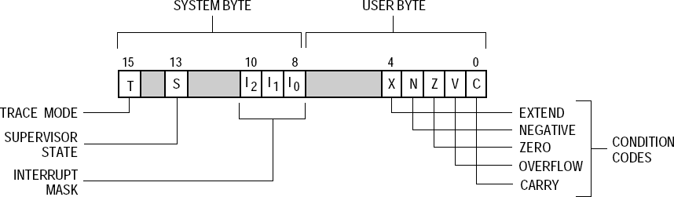
68000 Status Register

Slide 19
68000 Addressing Modes
Register direct
Register indirect
Register indirect with an Index
PC (program counter) relative with displacement
Absolute memory location
Immediate mode

Slide 20
68000 Priviliege Levels
Two levels of privilege:
  User mode, supervisor mode
User mode gave access to everything except the interrupt level control.
Supervisory privilege gave access to everything.
An interrupt always became supervisory.
The supervisor bit was stored in the status register, and visible to user program

Slide 21
Later Versions
68010
68020 – 32 bit address and data
68030 – memory management unit (MMU)‏
68040 – internal floating point unit (FPU), pipelining
68060
ColdFire. . . .

Slide 22
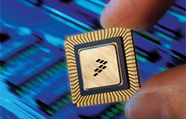
Freescale ColdFire (Motorola)‏

Slide 23
Overview
Runs at a higher frequency than 68K (20-100+ MHz)‏
An Enhanced Multiply-Accumulate Unit
10/100 Mbit Ethernet controller
UART (with DMA capability) for all your serial needs.
Flash
Address Decode and chip selects
Very small

Slide 24

Registers
16 general purpose 32-bit registers (D₀-D₇ for data, A₀-A₇ for addresses)‏
32-bit program counter
8-bit condition code register

Slide 25


Floating Point Registers
8 64-bit floating point data registers (FP₀-FP₇)‏
32-bit floating point control register (FPCR)‏
32-bit floating point status register (FPSR)‏
32-bit floating point instruction address register (FPIAR)‏

Slide 26
Addressing Modes
Data Register Direct Mode
Address Register Direct Mode
Address Register Indirect Mode
Address Register Indirect with Post-increment
Address Register Indirect with Pre-decrement
Address Register Indirect with Displacement
Address Register Indirect with Scaled Index and 8-Bit Displacement
Program Counter Indirect with displacement
Program Counter Indirect with Scaled Index and 8-Bit Displacement
Absolute Short Addressing
Absolute Long Addressing
Immediate Data Addressing

Slide 27
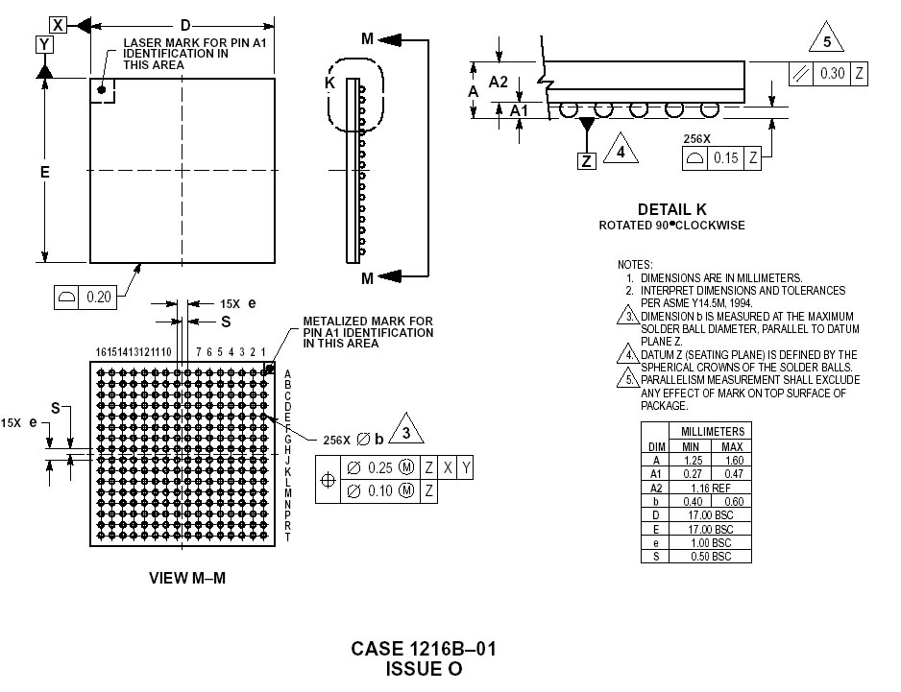
Any Reason Not to Use ColdFire?
Size

Slide 28
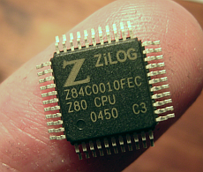
Zilog Z80

Slide 29
Z80 Overview
An 8-bit microprocessor designed and sold by Zilog from 1976 onwards.
Widely used both in desktop and embedded computer design as well as for military purpose.
Designed to be binary compatible with the Intel 8080 so that most 8080 code could run unmodified on it.

Slide 30
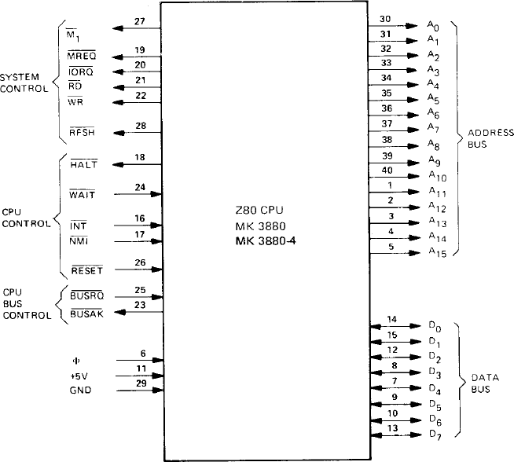
Z80 Pin Configuration

Slide 31
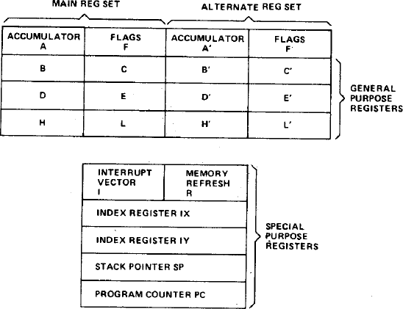
Z80 Registers

Slide 32

Z80 Flags
C – carry
Z – zero
S – sign
P/V – parity/overflow
H – half carry
B – add/subtract
Undocumented flag (D3, D5)‏

Slide 33
Z80 Addressing Modes
Immediate – operand follows OP code in memory
Immediate Extended – same as immediate, with 16 bit operand
Modified Page Zero – enables single-byte calls to commonly used subroutines at base of memory
Relative – one-byte (two’s complement) offset from PC

Slide 34
Z80 Addressing Modes
Extended – 16 bit address
Indexed – one-byte signed offset from an index register
Register – bits embedded in OP code
Implied – instruction operates on specific register
Register Indirect – address in general purpose register

Slide 35
Z80 Addressing Modes
Bit Addressing – three bits of OP code select bit to be operated on, combines with another addressing mode to specify byte
Combined Modes – different addressing modes may be used for source and destination operands

Slide 36
Z80 Interrupts
Non-maskable – execution transfers to location 0066h
Maskable – three modes:
Mode 0 – CPU executes instruction placed on data bus by device
Mode 1 – execution transfers to location 0038h
Mode 2 – device supplies lower byte of address of vector to handler, upper byte from I register

Slide 37
Beyond Z80
Z180 – MMU, DMA, UART, timer
eZ80 – embedded internet protocol stack (TCP/IP) – dynamic generation of web pages
www.zilog.com

Slide 38
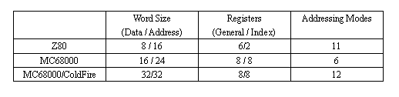
Processor Summary

Slide 39
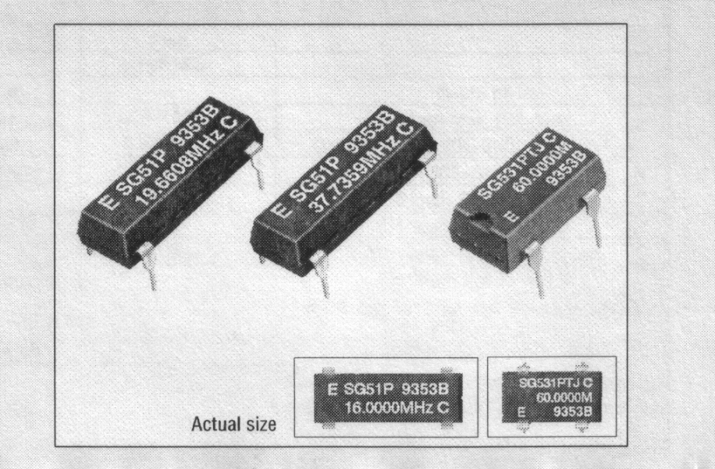
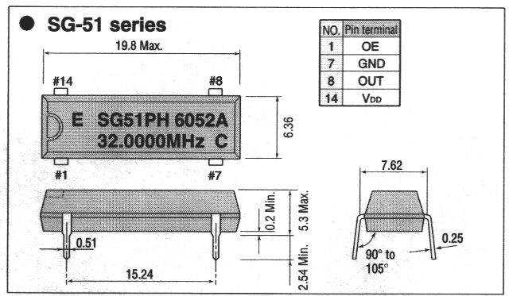
Crystal Oscillator Specification
SG-51P Full-Size (14-DIP) High-Frequency Crystal Oscillator
Available from 1 MHz – 26 MHz
Frequency dependent upon processor model
  MC68000L10 would require oscillator up to 10 MHz

Slide 40
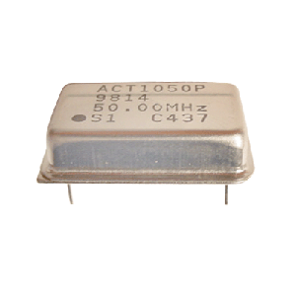
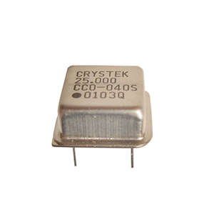
Other Oscillator Options
ACH/ACHL (half-size can)‏
ACO/ACOL (full-size can)‏
ASV (surface mount)‏
SG-531P (4-DIP)‏
SG-615P (surface mount)‏

Slide 41
Where to Order
Chip sockets (DIP Machine Tooled wire-wrap)‏
  Jameco - $0.53-$2.59/each
Board (at least 5” x 6.5”)‏
  Jameco ~ $5 (depending on size)‏
Wire wrap
  Jameco - $4.95/100’
  Digikey - $11.17-$24.26/100’

Slide 42
Where to Order (cont’d)‏
Wire wrap tools
  Digikey, RadioShack, Electronix Express
MAX691/694 Supervisory Chip
  Jameco - $6.25-$6.59
SG-51P Crystal Oscillator
  Digikey - $3.43

Slide 43
Where to Order (cont’d)‏
Zilog Z80 Processor
  Digikey - $9.21
Motorola 68000‏
  MC68HC000EI8 - $4.93 From DigiKey
Chip sockets (For PLCC package)‏
  DigiKey - $1.52 to $3.25

Slide 44
Data Sheets
Maxim – supervisory chip
Jameco
www.datasheetarchive.com
http://www.datasheet4u.com/

